Slide 1
OPTIMISATION TECHNIQUES
Summer ‘19

Slide 2
Presented by-
Kushagra Gupta (Mentor)
Department of Mathematics and Statistics
IIT Kanpur
kushgpt@iitk.ac.in
Mayuri Gedam
Department of Mechanical Engineering
IIT Kanpur
mvgedam@iitk.ac.in
Ayush Jain
Department of Electrical Engineering
IIT Kanpur
ayushj@iitk.ac.in
Ankur Banga
Department of Electrical Engineering
IIT Kanpur
ankurb@iitk.ac.in
Nitin Garg
Department of Mathematics and Statistics
IIT Kanpur
nitingrg@iitk.ac.in
Dhruvil Sangani
Department of Mathematics and Statistics
IIT Kanpur
vikrant@iitk.ac.in
Vikrant Malik
Department of Mechanical Engineering
IIT Kanpur
vikrant@iitk.ac.in
K Nikita
Department of Computer Science and Engineering
IIT Kanpur
nikitak@iitk.ac.in
Kartavya Jain
Department of Physics
IIT Kanpur
kartavya@iitk.ac.in
Shashwat Agrawal
Department of Mathematics and Statistics
IIT Kanpur
shashwat@iitk.ac.in

Slide 3
Three Parameter Weibull Distribution
We were supposed to maximize the likelihood function for the weibull distribution. The Ideal value of three parameters β,γ,η was estimated using a python script that effectively equated the partial derivative of MLE to 0.
MLE:
N log(𝛃) - N 𝛃 log(𝜼)+ (𝝱-1)∑ln(x) - ∑(x/η)^{𝝱} (1)
If 𝛄 approaches minimum value of sample-
(𝝱 - 1) log(min (t) - 𝛄) → ∞ (2)
𝞉f/𝝏𝝱 = 0 𝞉f/𝝏𝜼 = 0 (3)
𝜼 = [(1/N) ∑ (x^{𝛃})]^{𝛃} (4)
Complete Documentation and Scripts can be found at :
https://github.com/Ayushjain9501/convexOptim/tree/master/Assignments/Assignment%201

Slide 4
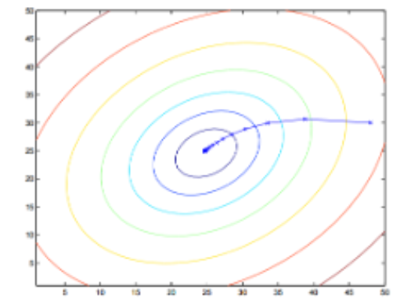
Batch Gradient Descent
Batch Gradient Descent computes the gradient of the cost function w.r.t. the parameters for the entire training set. The
update can be represented as follows:
Θ = Θ - 𝜼*∆_{Θ} J(Θ)T
This algorithm can be very slow as it iterates over the whole dataset just to perform a single update. It also can not
update our model online where new examples are being added. Batch gradient descent is guaranteed to converge to the
global minimum for convex error surfaces and to a local minimum for non-convex surfaces.
It can be visualized as:
Below is an implementation of this algorithm:
https://github.com/nitingarg1000/Optimization/tree/master/Batch_Gradient_Descent

Slide 5
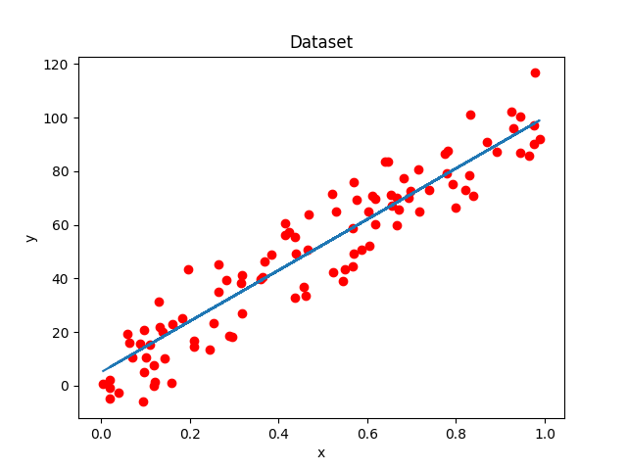
Stochastic Gradient Descent
Batch gradient descent performs redundant computations for large datasets, as it recomputes gradients for similar examples before each parameter update. SGD does away with this redundancy by performing one update at a time. It is therefore usually much faster and can also be used to learn online.
We try to fit a straight line to some randomly generated dataset using SGD. Parameter update for a randomly selected training example (x,y):
θ=θ−η∗∆J(θ,x,y)
Complete Documentation and Scripts can be found at :
https://github.com/Ayushjain9501/convexOptim/tree/master/Assignments/stochasticGD

Slide 6
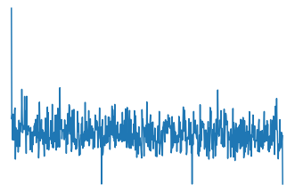
Mini Batch Gradient Descent
Mini-batch gradient descent performs an update for every mini-batch of n training examples. The update can be represented as follows:
θ=θ−η∗∆J(θ,x(i:i+n),y(i:i+n))
This reduces the variance of the parameter updates, which can lead to more stable convergence. Common mini-batch sizes range between 50 and 256, but can vary for different applications. Mini-batch gradient descent is typically the algorithm of choice when training a neural network and the term SGD usually is employed also when mini-batches are used.However it does not guarantee good convergence. Below is an implementation of this algorithm:
https://github.com/V1krant/Optimisation-Techhniques.git

Slide 7
Matrix Factorization

Slide 8
The solution of Bx=b mostly calculated by finding B⁻¹ i.e. x=B⁻¹b.
But calculating B⁻¹ is cumbersome especially when B is nearly singular.
So factorization or decomposition methods are used to break B into easy to use matrices.

Slide 9
LU and PLU Factorization for basis B
The idea is to break B matrix into a lower and a upper triangular matrix.
LU Decomposition exits only when U can be converted to row echelon form using Gaussian elimination without ever interchanging two rows.
Let G_{i} be permutations applied on U to convert to a Upper triangular matrix.
(G₁G₂…..G_{n})B = U -> B=LU
Bx=b -> L(Ux) = b
If LU decomposition isn’t possible , PLU is used.

Slide 10
QR Factorization for a Basis B
This factorization is most suitable and is used frequently for solving dense equation systems.
B is factored into B = QR, where Q is a orthogonal matrix and R is an upper triangular matrix.
The matrix B is first reduced to an upper triangular form R by premultiplying it with a sequence of square, symmetric orthogonal matrices Q_{i}… B_{i-1} = Q_{i-1} ….Q₁B.
The matrix Q_{i} is a square, symmetric orthogonal matrix of the form Q_{i} = 1 – 𝛾_{i}q_{i}q_{i}^{T}, where q_{i} = (0, ..., 0, q_{ii} ,...,q_{ni})’ and 𝛾_{i} belongs to R^{T} are suitably chosen to perform the foregoing operation.
Defining Q = Q_{n-1}. . . …Q₁, we see that Q is also a symmetric orthogonal matrix and that QB = R, or that B = QR, since Q = Q^{T} = Q⁻¹ that is, Q is an involutory matrix.
Now, to solve Bx = b, we equivalently solve QRx = b or Rx = Qb by finding b’ = Qb first and then solving the upper triangular system Rx = b’ via back-substitution.
Since ||Qv|| = ||v|| for any vector v, we have ||R|| = ||QR|| = ||B||, so that R preserves the relative magnitudes of the elements in B, maintaining stability. This is its principal advantage.

Slide 11
Cholesky Factorization LL^{T} and LDL^{T} for Symmetric, Positive Definite Matrices B
This method is only applicable for square symmetric matrix B which can be represented as B=L*L^{T}, where L is a lower-triangular matrix.
So L*L^{T} becomes a symmetric matrix and then by comparing the elements of both the symmetric matrices, we can figure out the elements of L.
The equation system Bx=b, can now be solved via L^{T}(Lx)=b, through the solution of two triangular systems of equations.
We first find y to satisfy Ly = b and then compute x via the system L^{T}x = y.
Sometimes we write B = LDL^{T} for the sake of accuracy as it avoids calculating the square root which otherwise was to be calculated in finding the elements of L.

Slide 12
References
[1] Stephen Boyd and Lieven Vandenberghe. Convex Optimization. Appendix A
[2] MOKHTAR S. BAZARAA HANIF D. SHERALI C. M. SHETTY . Non-linear programming theory and algorithms, Appendix A
[3] Ruder.io, An Overview of Gradient descent Algorithms,
http://ruder.io/optimizing-gradient-descent/index.html

